Slide 1


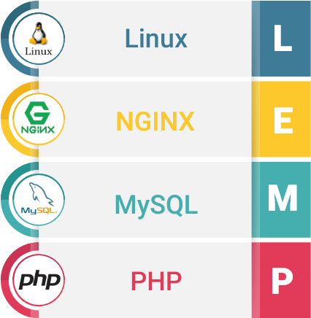
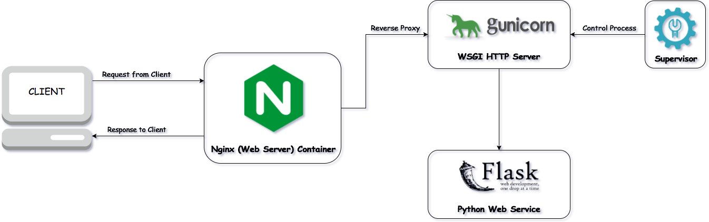
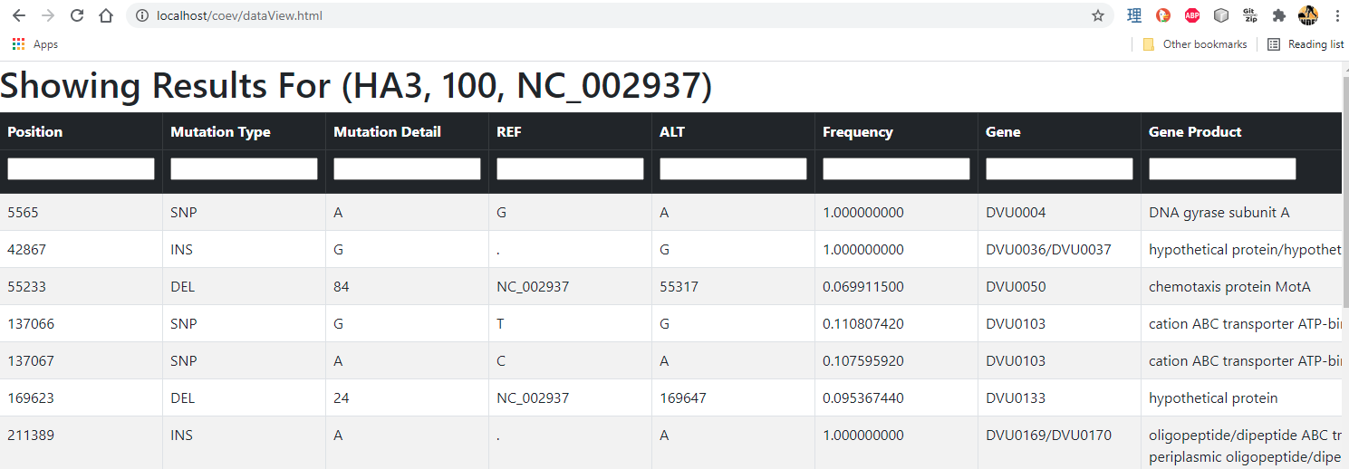






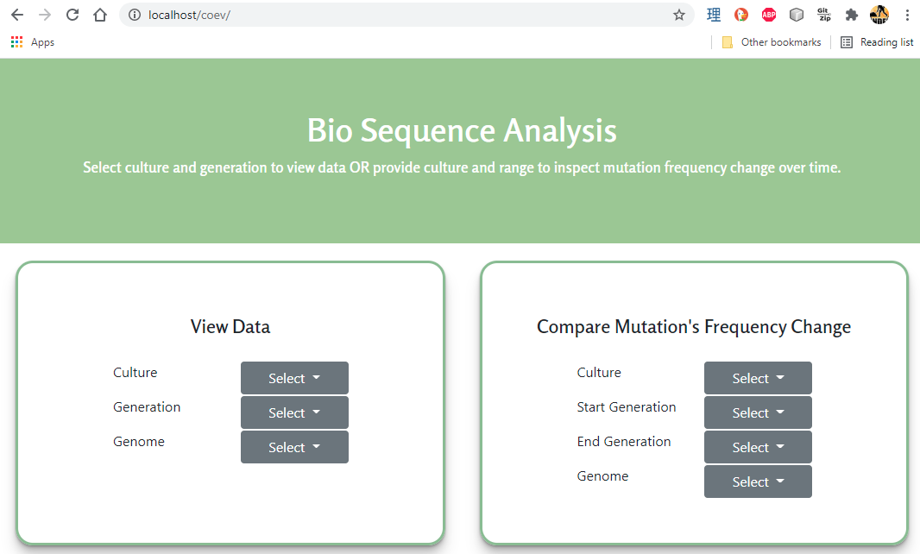
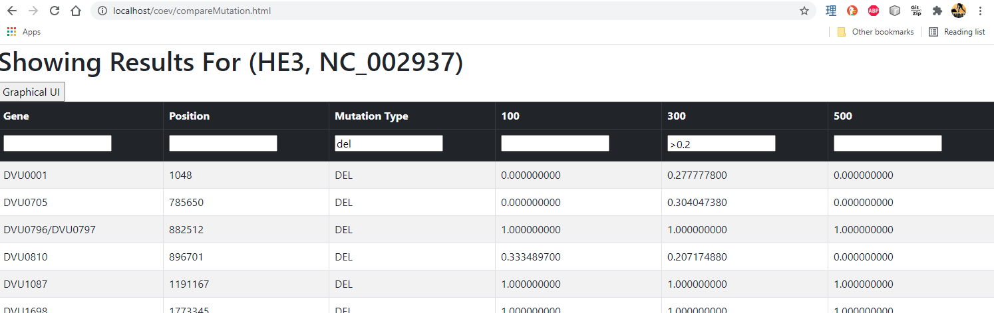
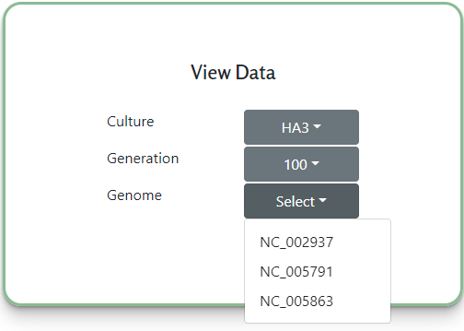
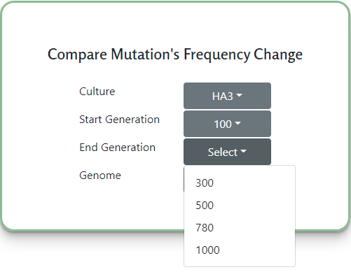
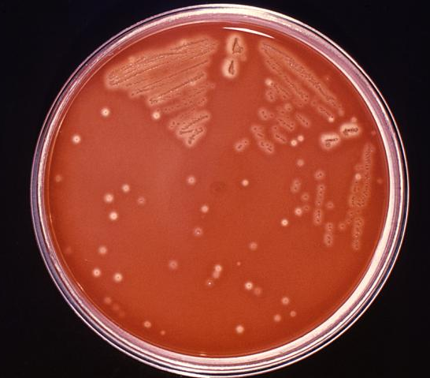
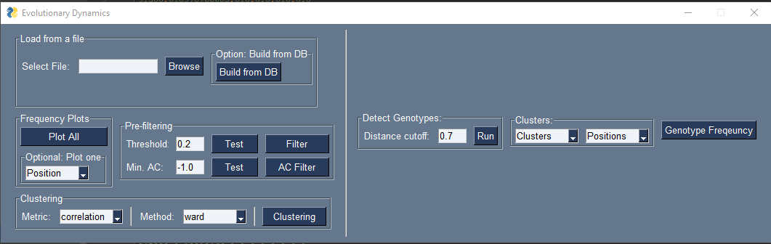
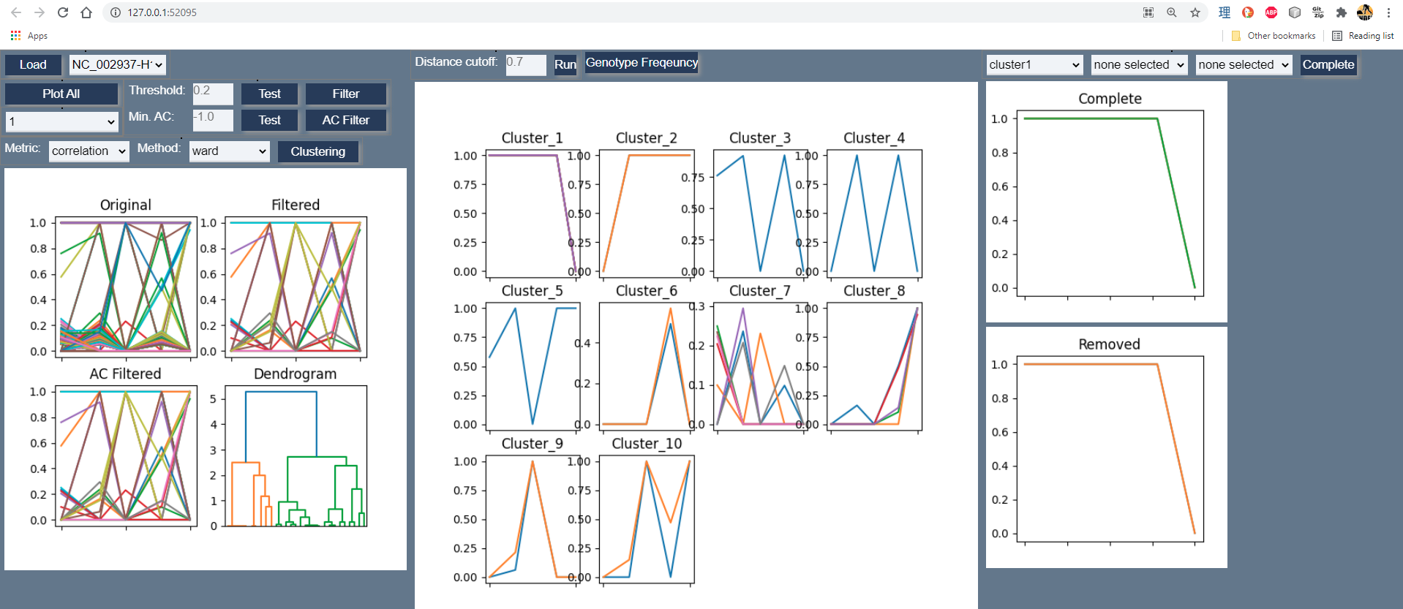
Web Application for Genome Sequencing Analysis
Student: Victor Avelar
Faculty: Professor Wooyoung Kim
Degree: CSSE
Date: June 11, 2021
The biology department collects genomes of two organisms over many generations to analyze the co-evolutionary process.
This scientific research generates a plethora of data, which must be processed and presented graphically in a way that is meaningful to the researchers. We develop a web application using the LEMP stack that conducts sequencing analysis, storing data in MySQL databases, and displaying the data as requested with filtering and sorting functionality. In addition, the web application provides a program to analyze the frequency changes of all mutations during evolution.
Data Display Selection
Filtering/Sorting Display
Technologies Used
This is the main page a user will see when using the web application. The “Select” dropdowns use php to query for the relevant items available. Javascript keeps track of what has been selected, as previous choices affect the next selection box.
> The “View Data” box has three selections, culture, generation, and genome which load based on items in the database. When all three are selected, the data view page is loaded with the relevant queries.
> The “Compare Mutation’s Frequency Change” box has similar functionality to the “View Data” however the mutation view page loads different data relevant to the items selected.
All processed data is stored in a MySql database. Once a user selects the relevant items on the main page, the results page will be loaded.
> Javascript with jquery used to populates elements of an html table.
> Clicking a column header sorts rows by ascending descending, and each column can be filtered.
The first iteration was built using the LEMP stack. A second reverse proxy server using Gunicorn was required for processing python on the biolabs CentOS 7 environment.
Conclusion and Learning Outcomes
PHOTO HERE
Freq. Change Web GUI
The end result is a centralized web application that speeds up the workflow of researchers conducting the co-evolution experiments.
> Experience building a LEMP stack web application
> Experience configuring a Nginx server with php and as reverse proxy with Gunicorn
> Experience adapting and extending an existing code base (python GUI)
> Experience working cross discipline (biology) to build an application that has value to users
Microbe Culture Crossed Together To Produce New Cultures
The main page with “View Data” and “Compare Mutation’s Frequency Change” options. Selecting the last option will load a new html page with the relevant data.
A previous student wrote a python GUI for gene frequency visualization. This was ported to launch as a web application.
> Additional filtering feature for clusters was developed.
D1
A: HA3, UA3
M1
E: HE3, UE3
R: HR2, UR1
When a “Select” dropdown is clicked, the html elements are dynamically loaded with javascript. Javascript functions use ajax calls to php files which are responsible for querying the database with the relevant items. When new items are added to the database,
D2
S: HS3, US1
H1, H2, U1, U2
M2
H5, H6, U5, U6

